Slide 1
Final Presentation Team Black
Bühler Ueli, Jahn Tim Allan, Kandiah Rajilatha,
Klembowski Raphael, Ristic Nikola, Sutter Christoph

Slide 2
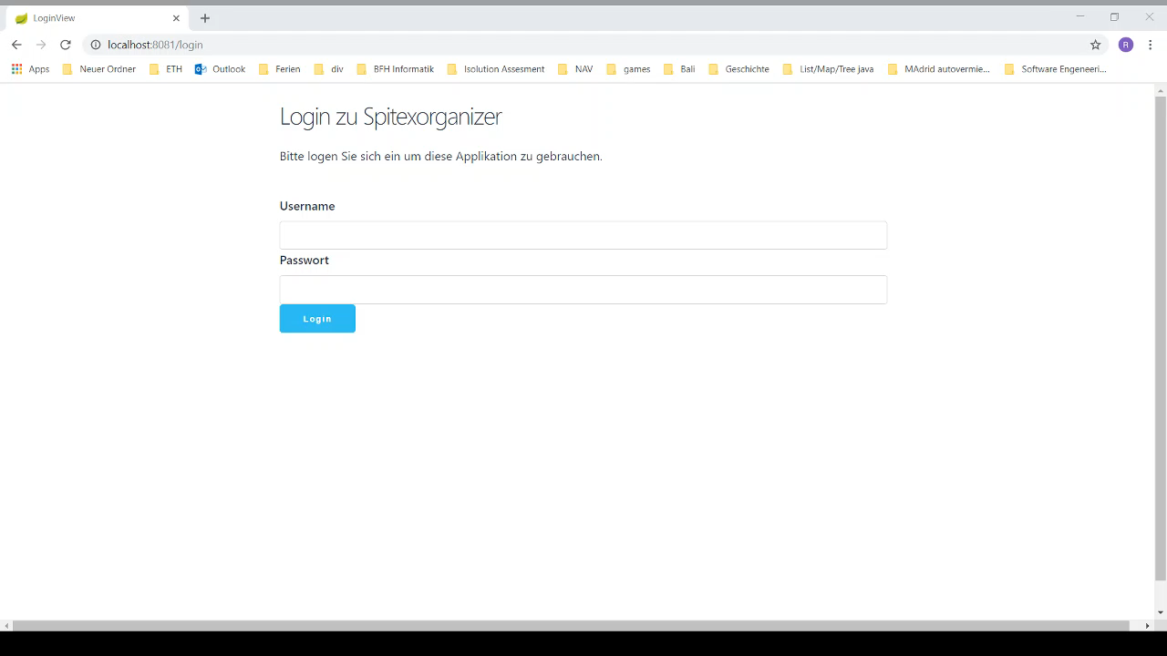
Screencast

Slide 3
features implemented vs. design thinking ideas
features implemented vs. design thinking ideas
All features included
Prototyps don’t look like final Version

Slide 4
architecture & coding highlights
Spring
Hybernate
MVP
H2

Slide 5
list of personal contribution for each team member
Ueli and Tim

Slide 6
Scrum retrospective

